Slide 1
Inter-process Communication
IPC

Slide 2
A process contains everything needed for execution
◆ An address space (defining all the code and data pages)
◆ OS resources (e.g., open files) and accounting information
◆ Execution state (PC, SP, regs, etc.)
◆ Each of these resources is exclusive to the process

Slide 3
Processes need to interact with each other
inter-process communication (IPC) is the term used to refer to the activity of sharing data across multiple processes, via communication protocols

Slide 4
Inter-process communication Methods:
Shared memory - permits processes to communicate by simply reading and writing to a specified memory location.
Mapped memory is similar to shared memory, except that it is associated with a file in the filesystem.
File - A record stored on disk, or a record synthesized on demand by a file server, which can be accessed by multiple processes.
Pipe -A two-way data stream between two processes interfaced through standard input and output and read in one character at a time. Pipes permit sequential communication from one process to a related process.
Message passing - Allows multiple programs to communicate using channels, commonly used in concurrency models.
Sockets support communication between unrelated processes even on different computers.

Slide 5
Area of Essential IPC
Modern operating systems execute processes concurrently
Processes need cooperate and Compete with each other

Slide 6
Process Cooperation
Processes are cooperating if they can affect each other. The simplest example of how this can happen is where two processes are using the same file. One process may be writing to a file, while another process is reading from the file; so, what is being read may be affected by what is being written. Processes cooperate by sharing data. Cooperation is important for several reasons:
Information sharing: Several processes may need to access the same data (such as stored in a file.)
.

Slide 7
Computation speedup: A task can often be run faster if it is broken into subtasks and distributed among different processes. This depends upon the processes sharing data. (Of course, real speedup also required having multiple CPUs that can be shared as well. For example, consider a webserver which may be serving many clients. Each client can have their own process or thread helping them. This allows the server to use the operating system to distribute the computer's resources, including CPU time, among the many clients.

Slide 8
Convenience: An individual user can run several programs at the same time, to perform some task. For example, a network browser is open, while the user has a remote terminal program running (such as telnet), and a word processing program editing data

Slide 9
Process Competition
Computer resources are too few compared to process
Proccess are always in a race condition where each process attempts to grab the resource it requires

Slide 10
Areas of essential IPC include
Mutual Exclusion
Synchronization
Deadlock prevention

Slide 11
Mutual Exclusion
Computer resources are either sharable or non-sharable
mutual exclusion refers to the act of ensuring that no two concurrent processes access a non-sharable resource at the same time
it is a basic requirement in concurrency control, to prevent race conditions

Slide 12
Process Synchronization
Process synchronization refers to the idea that multiple processes are to join up or handshake at a certain point, in order to reach an agreement or commit to a certain sequence of action

Slide 13
Resolving IPC Issues
IPC is facilitated through the use of semaphores and monitors

Slide 14
Semaphore
A semaphore is an abstract data type that is used for controlling access, by multiple processes, to a common resource in a parallel programming or a multi user environment
A semaphore is a protected variable whose value can be accessed and altered only by the operations W and S and initialization operation called 'Semaphoiinitislize'
Semaphore concept introduced by E. W. Dijkstra (1965) after studying rail line communication

Slide 15
Semaphore Features
Non – Negative integer
Its value is initialized – set to a certain value
Acted upon by two operation of WAIT and SIGNAL
Operations are indivisible - The operations of Wait or Signal are atomic.

Slide 16
WAIT and SIGNAL operations
WAIT decrements semaphore value by 1
S=s-1
SIGNAL operation increments the semaphore value by 1
S=s+1
A wait operation signifies that a resource which was free has been taken over by a proces
A signal operation signifies that a resource has been freed by a process

Slide 17
When Wait is executed by a thread, we have two possibilities:
The counter of S is positive In this case, the counter is decreased by 1 and the thread resumes its execution.
The counter of S is zero In this case, the thread is suspended and put into the private queue of S.
When Signal is executed by a thread, we also have two possibilities:
The queue of S has no waiting thread The counter of S is increased by one and the thread resumes its execution.
The queue of S has waiting threads In this case, the counter of S must be. One of the waiting threads will be allowed to leave the queue and resume its execution. The thread that executes Signal also continues.

Slide 18
Critical Section Problem
In concurrent programming, a critical section is a part of a multi-process program that may not not be concurrently executed by more than one of the program's processes/threads
The critical section of a resource is the point at which access is made to the resource

Slide 19
The protocol developed for solving the Critical Section Problem involved three steps:
Entry section: Before entering the critical section, a process must request permission to enter
Critical section: After permission is granted, a process may execute the code in the critical section. Other processes respect the request, and keep out of their critical sections.
Exit section: The process acknowledges it has left its critical section.

Slide 20
Resolving Mutual Exclusion
How do we ensure that a non-sharable resource is only accessed by one process at a time.
Identify the critical section of the resource
Enclose the critical section with a single semaphore and initialize its value to 1

Slide 21
Resolving Process synchronization
Identify the points at which the processes need to be synchronized
Enclose the two points with a single semaphore and initialize its value to 0
Let the dependent process perform a wait operation and the other a signal operation

Slide 22
Process Deadlock
A deadlock is a situation in which two computer programs sharing the same resource are effectively preventing each other from accessing the resource, resulting in both programs ceasing to function.

Slide 23
Conditions Necessary and Sufficient for a process Deadlock
1. Mutual Exclusion Condition The resources involved are non-shareable. Explanation: At least one resource (thread) must be held in a non-shareable mode, that is, only one process at a time claims exclusive control of the resource. If another process requests that resource, the requesting process must be delayed until the resource has been released. 2. Hold and Wait Condition Requesting process hold already resources while waiting for requested resources. Explanation: There must exist a process that is holding a resource already allocated to it while waiting for additional resource that are currently being held by other processes. 3. No-Preemptive Condition Resources already allocated to a process cannot be preempted. Explanation: Resources cannot be removed from the processes are used to completion or released voluntarily by the process holding it.
4. Circular Wait Condition The processes in the system form a circular list or chain where each process in the list is waiting for a resource held by the next process in the list

Slide 24
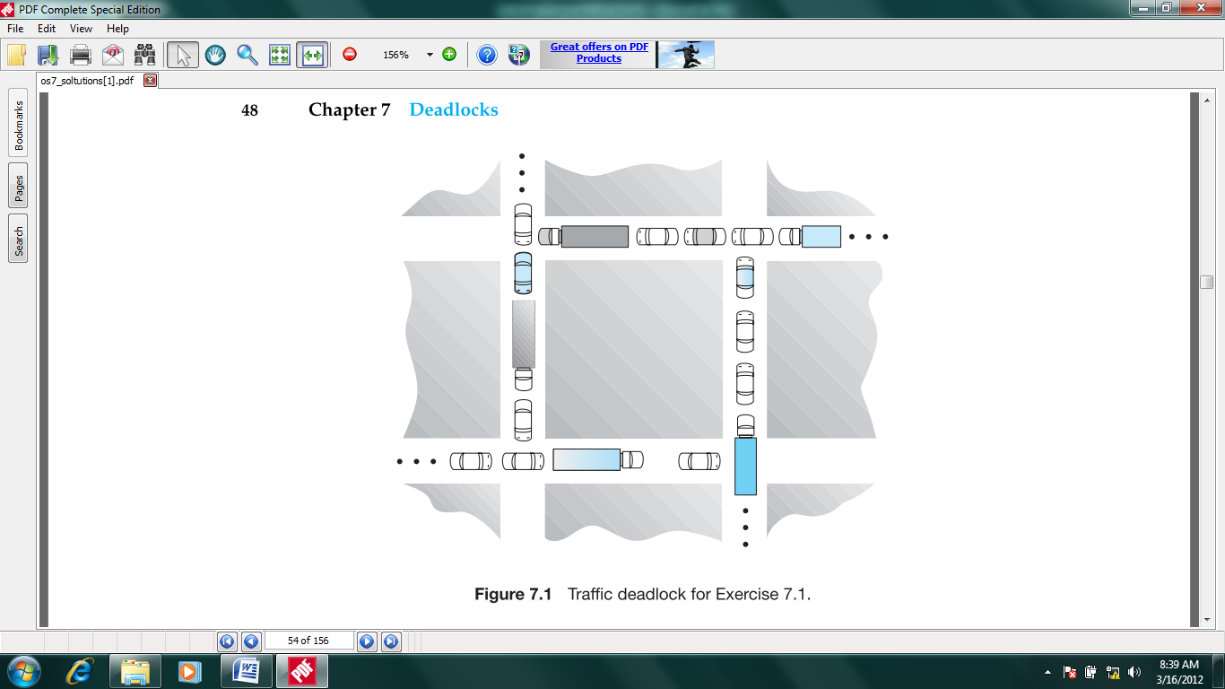
As an example, consider the traffic deadlock in the following figure

Slide 25
Consider each section of the street as a resource.
Mutual exclusion condition applies, since only one vehicle can be on a section of the street at a time.
Hold-and-wait condition applies, since each vehicle is occupying a section of the street, and waiting to move on to the next section of the street.
No-preemptive condition applies, since a section of the street that is a section of the street that is occupied by a vehicle cannot be taken away from it.
Circular wait condition applies, since each vehicle is waiting on the next vehicle to move. That is, each vehicle in the traffic is waiting for a section of street held by the next vehicle in the traffic.

Slide 26
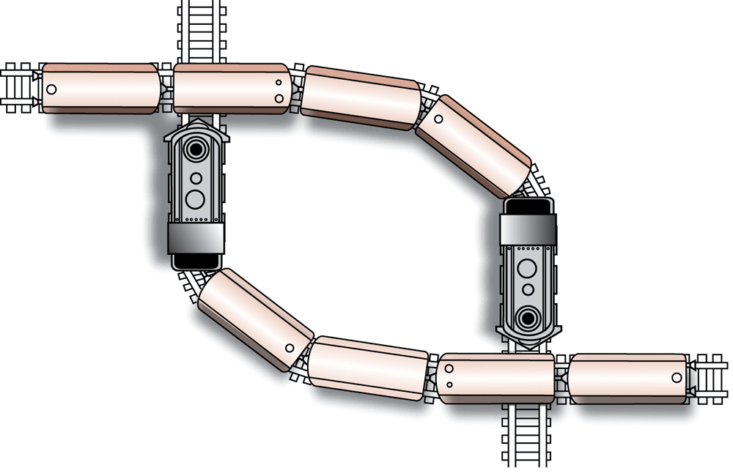
A deadlock resulting from competition for nonshareable railroad intersections

Slide 27
Dealing With Deadlocks
Prevention
Avoidance
Detection and recovery
Ignorance

